Slide 1

Group 3
Salem Alsuwaidi, Riley Payung

Slide 2
Introduction
Problem: Create a reverse chart of the movies diagram
Theory: Salem Alsuwaidi
Coding & Analysis: Riley Payung

Slide 3
Goals and theory
Goals:
Changing the nodes in order to represent movies instead of actors, and having the connections represent actors instead of movies.
To be able to calculate the YACL for the movies
Theory:
Our theory is to first swap the nodes and have them represent movies instead of actors and the connections represent actors instead of movies.
Second, we will create connections between nodes based on common actors
Third, we will calculate the distance between these nodes and try to achieve the shortest possible path
Finally, we will calculate the YACL and analyze our results

Slide 4
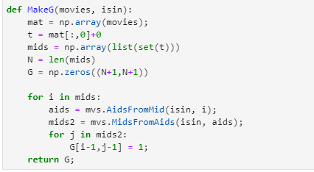
Code
Reversal of MakeG
Added MidsFromAids
Not many changes here
Notes:
My name is Riley Payung, and I did the coding and analysis sections of the project. Ultimately, I had to change one fundamental function, the MakeG function. Now, it includes the movies data and the isin data. This function works as a reversal of the MakeG function for the homework. I had to create a matrix of all of the movies, get the AIDS from each MID, and find the mids from each actor to set up the graph. Not all that much changed. I also had to make the MidsFromAids function, which worked similarly to the function for the homework that we had to create.

Slide 5
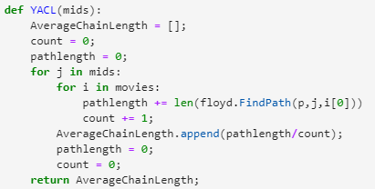
Code (cont.)
Building the graph worked in the same manner.
YACL function
Notes:
After building the graph, I built the YACL function. The YACL function takes in mids (ideally from a subset of a specific year). It then goes and calculates the average chain length of each mid across all movies. The function then returns this ACL.

Slide 6
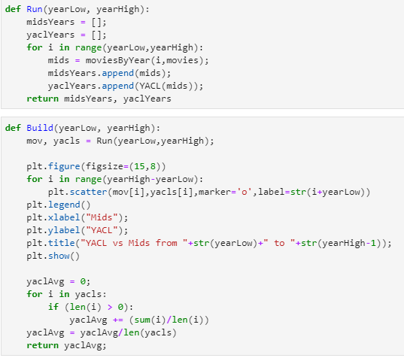
Code (cont.)
Run Function
Build Function
Notes:
I also built two more functions. The first, Run(), takes in the lower bound year and the upper bound year, then returns the mids from those years and the year average chain length for all of the returned years. These values are then returned. The build function takes in the same parameters, because it builds with the run function. Build then creates a scatter plot of the movies and YACLs from those years. The average yacl between the years span is then calculated. The total decade YACL is then returned.

Slide 7
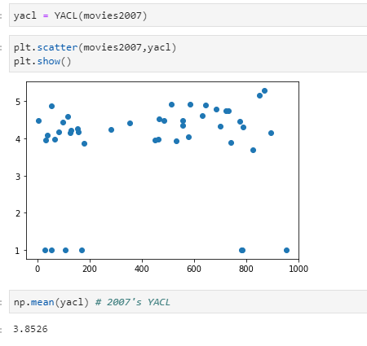
Analysis
Analysis of 2007
Notes:
Moving onto the analysis, the average for the year 2007 that was obtained was 3.8526. This seems a little low, and it was because I was stuck in an infinite loop in the runFloyd function, so i cut it when it reached 1000 length, then returned an empty list. It may also be worth the time to remove the zero/one values to get a better estimate. Shown here is the YACL and the scatter plot of such.

Slide 8
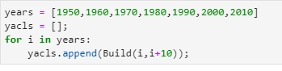
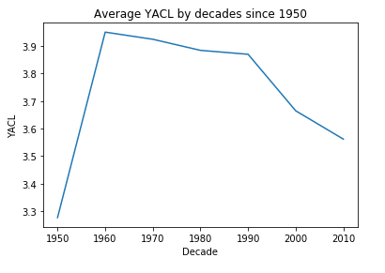
Analysis (cont.)
1950s to 2010s
The function builds a graph every 10 years.
Notes:
Making use of the build function, I was able to calculate the averages for decades from 1950s to the 2010s. The results are shown in the scatter plot above. More on this part can be seen in the actual file and in the following slides.

Slide 9
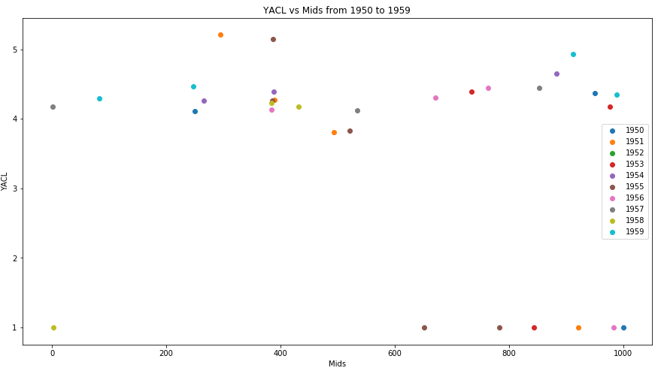
Decades Analysis

Slide 10
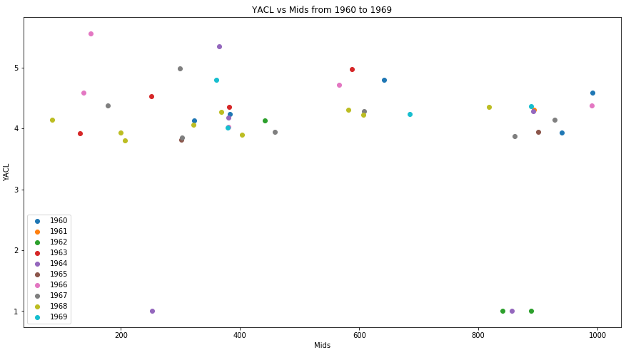
Decades Analysis

Slide 11
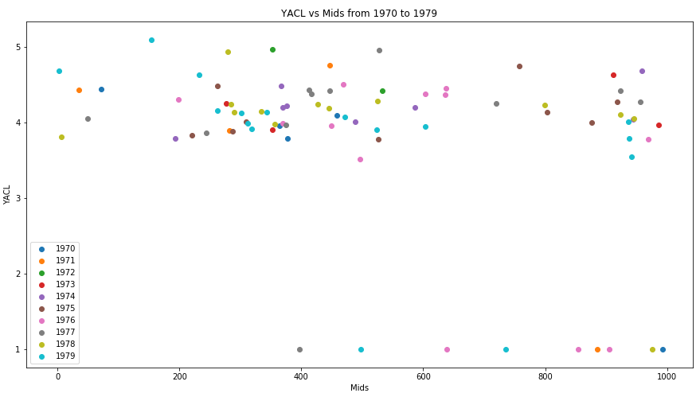
Decades Analysis

Slide 12
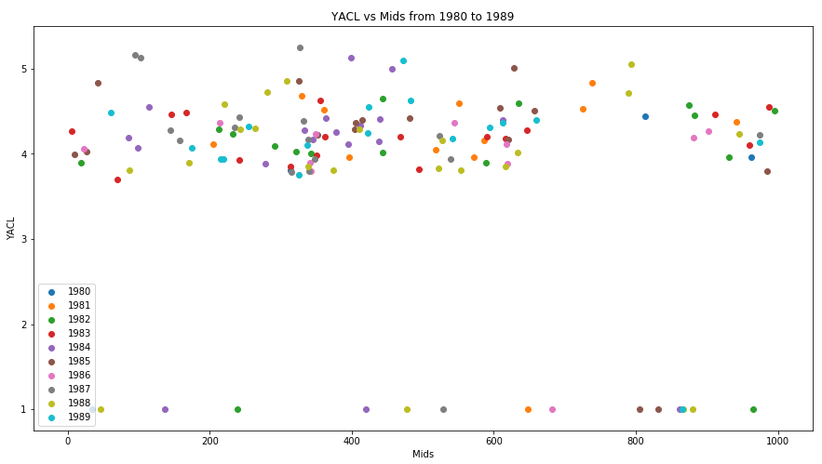
Decades Analysis

Slide 13
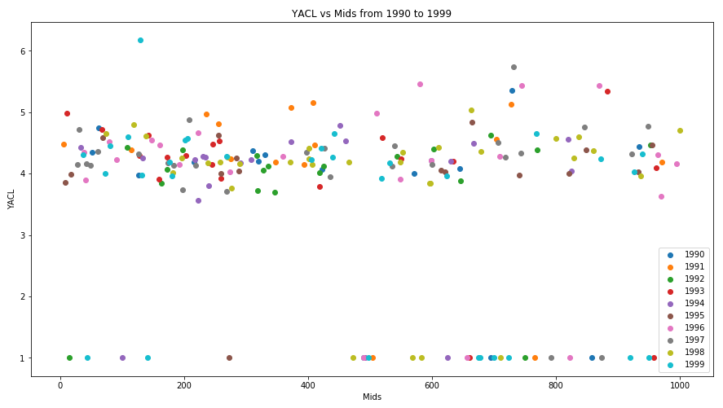
Decades Analysis

Slide 14
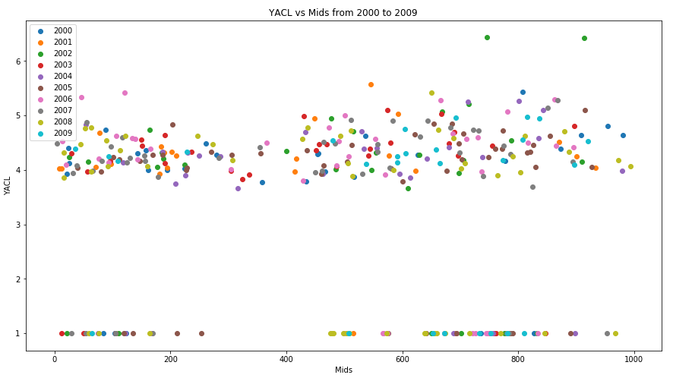
Decades Analysis

Slide 15
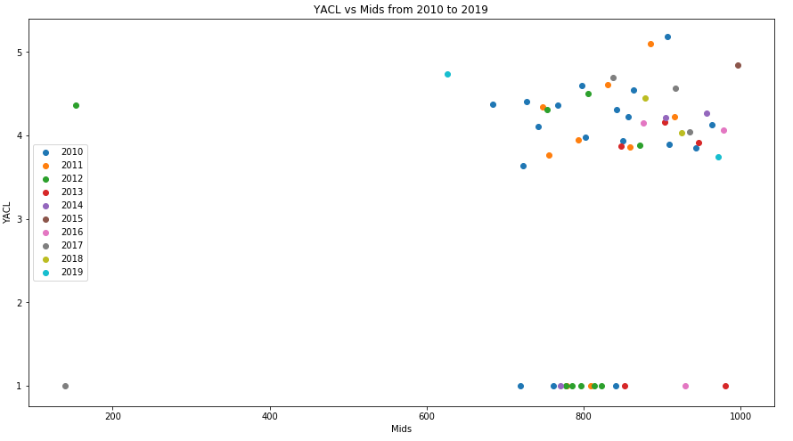
Decades Analysis

Slide 16
Conclusion
Highest decade YACL was between the years of 1960 and 1969.
Lowest decade YACL was between the years of 1950 and 1959.
Average for all decades was around 3.7.

